Slide 1

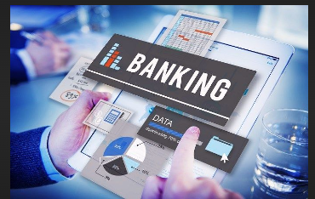
Bank Prediction and Detection
Submitted by-
Janvi Sethi (2210990431)
Jashanjit Kaur(2210990440)
Jasleen Kaur(2210990447)
Kashika (2210990493)
Supervised by-
Ms. Shagun Sharma

Slide 2
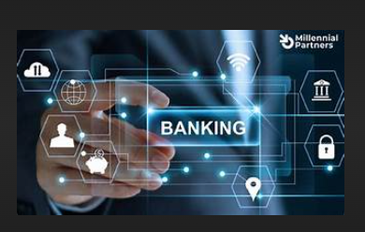
Table Of Contents
Introduction
Problem Statement
Technical Details
Key Features
Project Highlights
Conclusion
References

Slide 3

Introduction
In today's digital age, the integration of data science and machine learning has revolutionized how banks and insurance companies operate, enabling them to harness the power of data for informed decision-making and improved customer experiences. In this Project we have added “Loan Approval Prediction “, “Loan status Prediction", "Bank Customer Churn Prediction” and “Credit Card Fraud Detection” by using machine Learning .

Slide 4

Problem Statement
In the realm of banking and insurance, the efficient handling of loan approval, loan status monitoring, and customer churn detection poses significant challenges. The problem lies in accurately predicting loan approval for new applicants, monitoring the status of existing loans to prevent defaults, and detecting potential customer churn to ensure retention. By developing models that can predict loan approval probabilities, monitor loan statuses for early warning signs of defaults, and forecast customer churn probabilities, financial institutions can optimize their operations, mitigate risks, and enhance customer satisfaction.

Slide 5
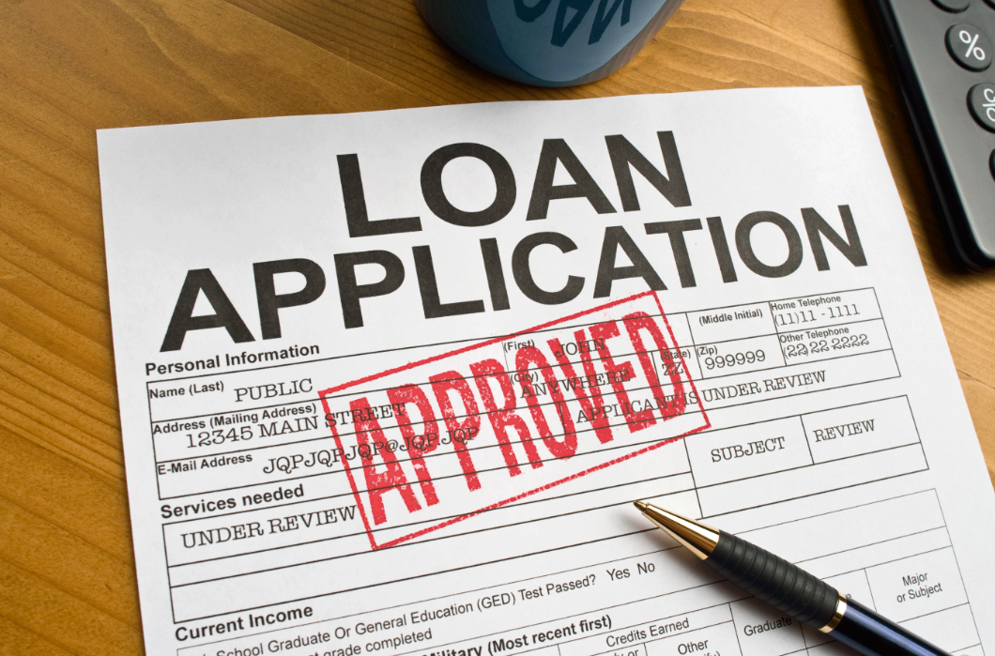
Technical Details
Machine Learning Algorithms: Logistic Regression, Decision Trees, Random Forests, Support Vector Machines (SVM), Gradient Boosting Machines (GBM).
Feature Engineering: Identification and engineering of relevant features. Techniques: one-hot encoding, feature scaling, PCA.
Model Evaluation: Cross-validation, stratified sampling Metrics: accuracy, precision, recall, F1-score, ROC-AUC.
Hyperparameter Tuning: Grid search, random search, Bayesian optimization.
Data Preprocessing: Handling missing values, outliers, and imbalance. Data cleaning, normalization, transformation.

Slide 6

Key Features
Customer Demographics: Age, gender, marital status, occupation, income level, etc.
Credit History: Previous loan performance, credit score, credit utilization, repayment history.
Financial Behavior: Spending habits, savings patterns, investment history.
Transaction History: Frequency, volume, types of transactions, account balances.
Loan Details: Loan amount, interest rate, loan term, type of loan (e.g., mortgage, personal loan).
Insurance Policies: Type of insurance coverage, policy duration, claims history.
Interaction History: Customer service interactions, complaints, feedback.
Market Conditions: Economic indicators, interest rate fluctuations, industry trends.
Risk Factors: External risks (e.g., economic downturns, natural disasters) and internal risks (e.g., operational risk, credit risk).

Slide 7
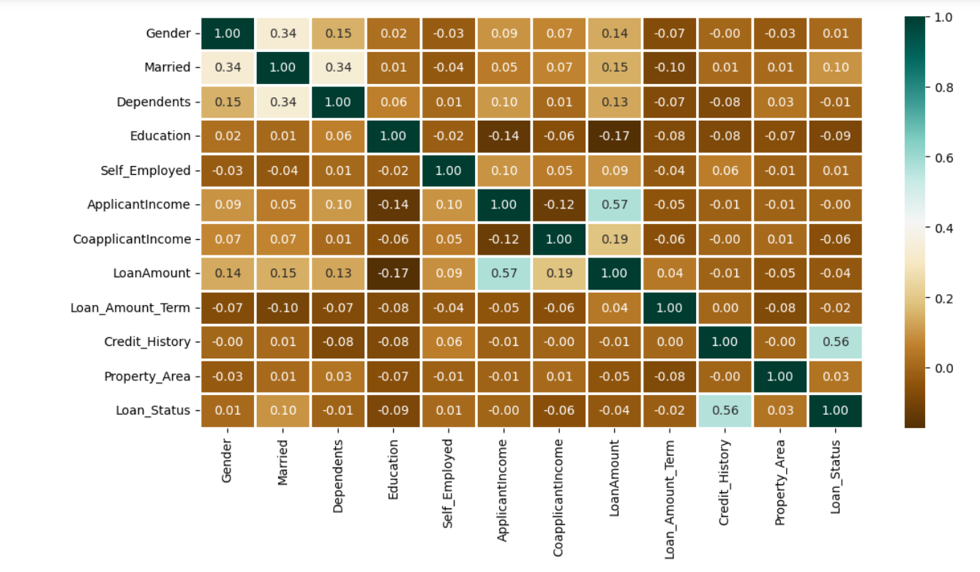
Project highlights
Heat Map for loan approval -

Slide 8
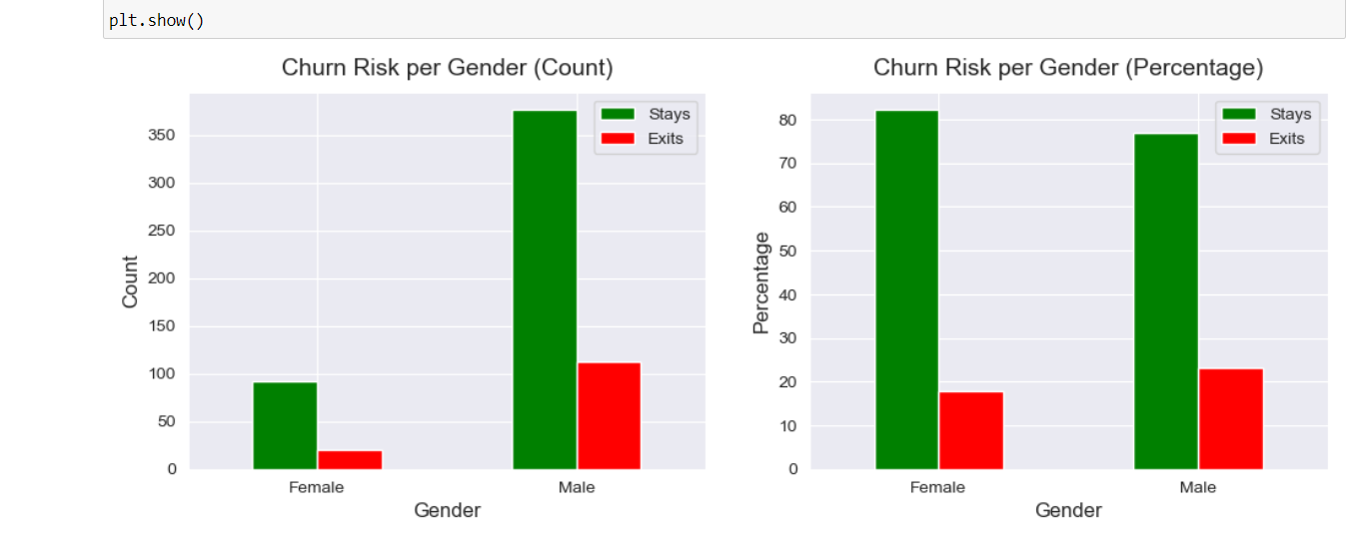
Banking Customer Churn Prediction-

Slide 9


By testing and training from different classifier from loan status prediction-

Slide 10
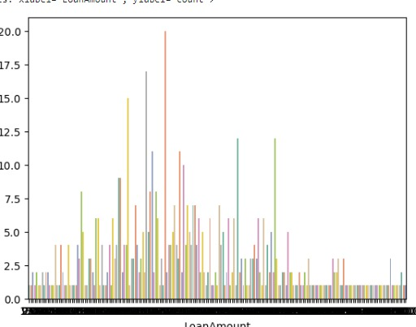
Loan amount-

Slide 11
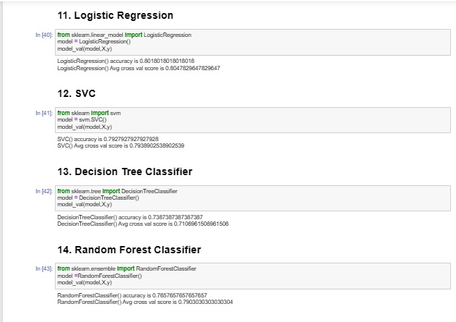
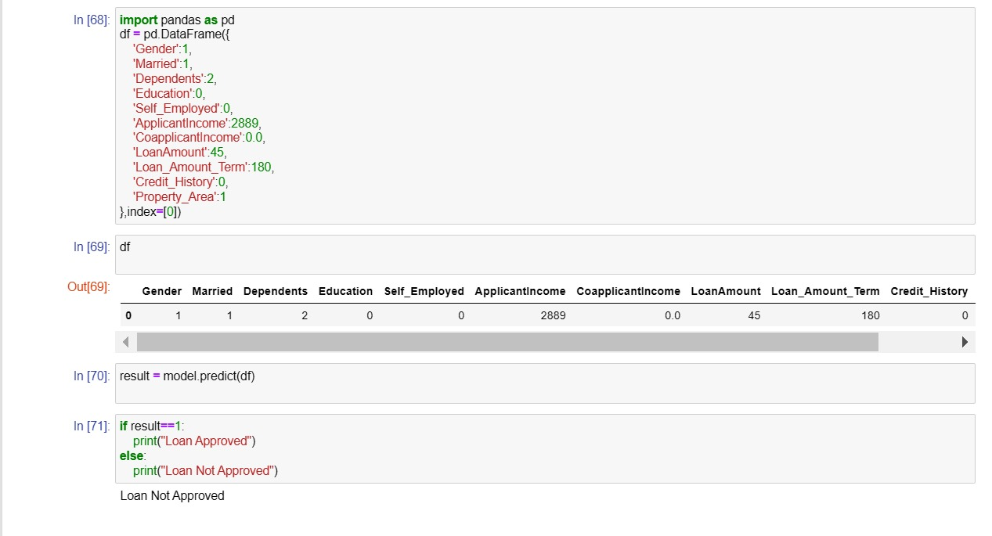
Loan approved or not-

Slide 12

Conclusion
In conclusion, leveraging advanced analytics and machine learning techniques offers tremendous potential for banking and insurance sectors in enhancing loan approval processes, predicting loan outcomes, and managing bank customer churn. By integrating a wide array of data sources and employing sophisticated predictive models, financial institutions can make more informed decisions, mitigate risks, and optimize customer satisfaction. Through continuous refinement and adaptation of these predictive systems, banks and insurance companies can stay ahead in a dynamic market landscape, driving growth and ensuring long-term competitiveness.

Slide 13

References
1.Kaggle: https://www.kaggle.com/code/yonatanrabinovich/loan-prediction-dataset-ml-project2.
2.Geeks for Geeks: https://www.geeksforgeeks.org/supervised-machine-learning/
https://www.geeksforgeeks.org/understanding-logistic-regression/
https://www.geeksforgeeks.org/support-vector-machine-algorithm/
https://www.geeksforgeeks.org/decision-tree/

Slide 14


